Slide 1

VAST CHALLENGE 2018 MC3 Final Review
Team Members
Supriya Bommisetty
Aravind Battula
Chandra Prem Putheti
Praveenkumar Reddy Veerapapireddygari
Siva Dharma Sastha Madala

Slide 2
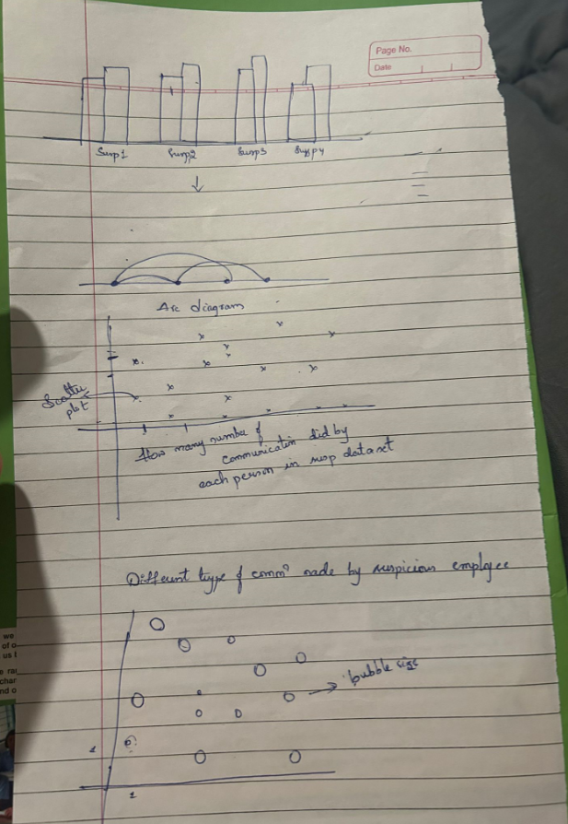
D3 Implementation Sketch

Slide 3
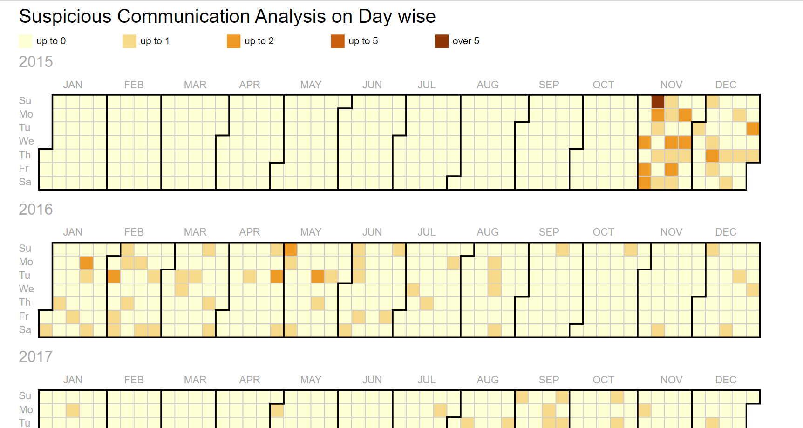
Calendar Heat Map
Here we are trying how many number of suspicious communications happened on each day.
Darker color indicates more number of communications and lighter color indicates less number of communications.

Slide 4
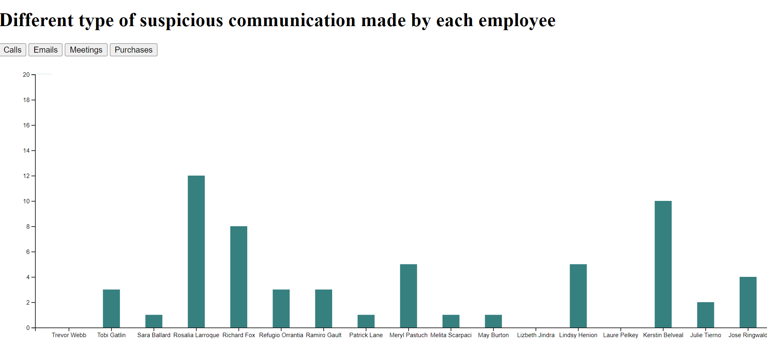
Bar Graph
Click on the buttons to find how many number of communications made by each employee

Slide 5
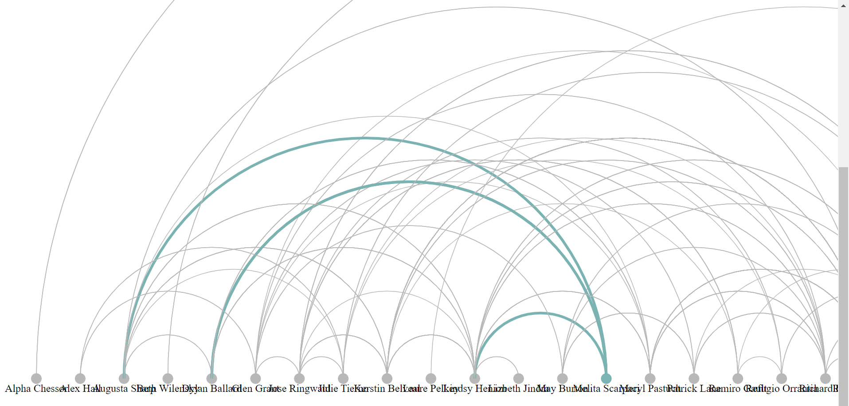
Arc Diagram
This graph helps us to understand the communications between different employees.

Slide 6
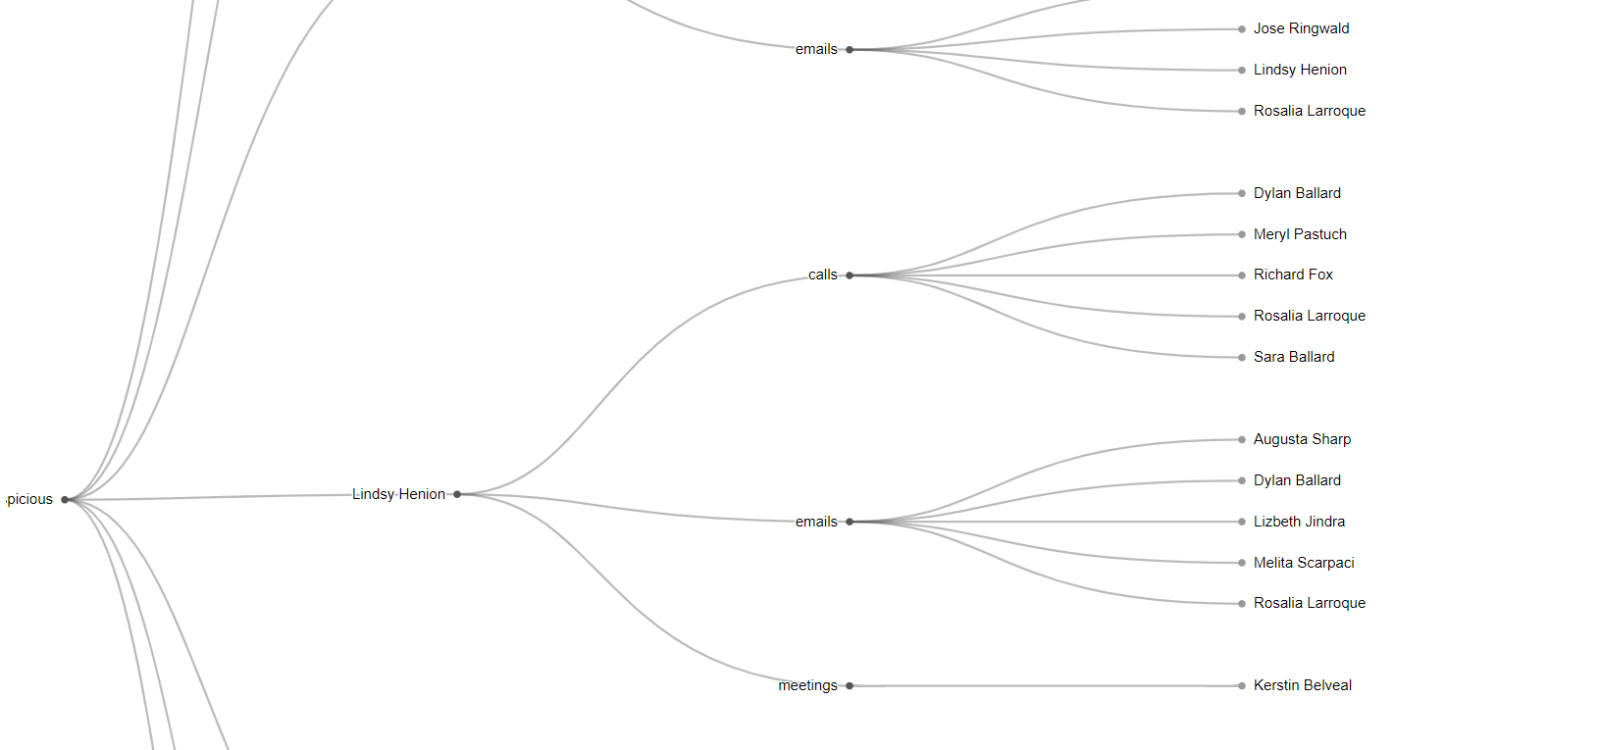
Dendogram

Slide 7

THANK YOU

